Slide 1
After Your First Award: Next Steps in Your Journey with NIH
Nastaran (Nas) Zahir, PhD
Chief, Cancer Training Branch, Center for Cancer Training

Slide 2
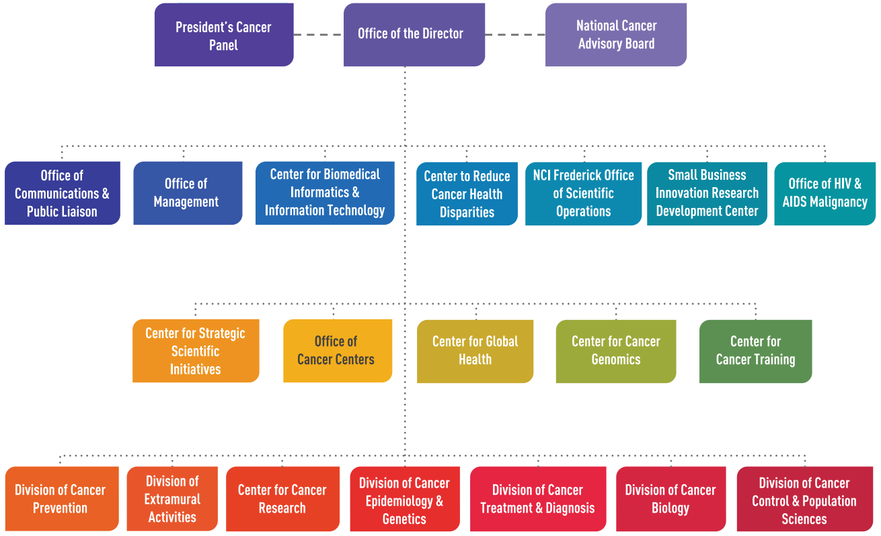
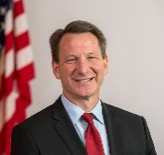
Organization of the National Cancer Institute
Director:
Norman “Ned” Sharpless, MD

Slide 3
You Got the Grant, Now What?
Leadership

Slide 4
Seek Leadership Training

Slide 5
Develop a Leadership Philosophy
What kind of leader do you want to be?
Authentic
Positive energy
Accountability
Decisive
Listen and follow through
Visionary (goal focused, willing to risk)
What are your core values?

Slide 6
Be a Good Mentor
Emulate yours
Suggest direction
Provide feedback and praise
Consider the needs of the individual
Look for growth opportunities
Don’t be equals
How could you have been helped?

Slide 7
Progress Reports
We really do read them

Slide 8
Got Results?
Where do the data lead?

Slide 9
How do you get there?
Chart your course
Do you need:
Funding
Collaborators
Staff
Equipment
Resources

Slide 10
What is right for your stage?
https://researchtraining.nih.gov/career-path

Slide 11
Choosing an appropriate path for funding
R03 or R21
R21/R03

Slide 12
Already have an R01? Which path to choose next?
Competing Renewal vs. New Application?

Slide 13
Funding: Selecting the right opportunity
Finding Funding Opportunity Announcements (FOAs)
Moving away from PAs to NOSIs
https://www.grants.nih.gov/
PA: program announcement
NOSI: notice of special interest

Slide 14
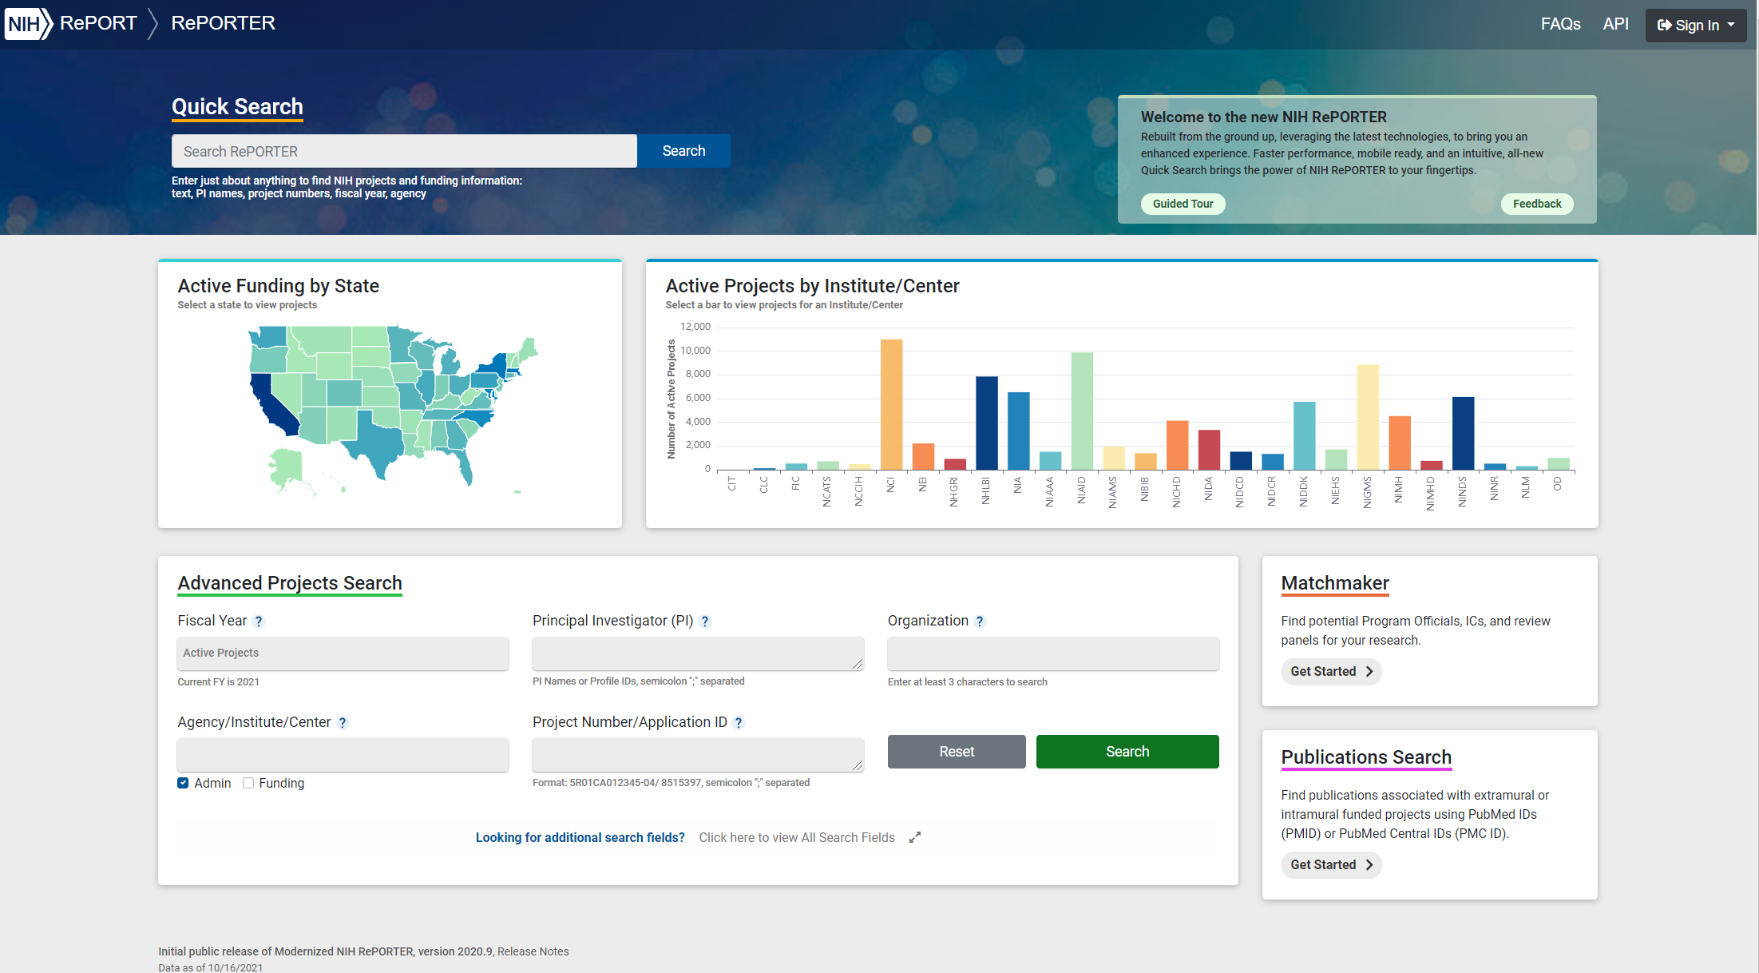
Finding Contacts & Mentors
https://reporter.nih.gov/

Slide 15
Foster Your Network
Your friends may become your collaborators
Science is a small world
Don’t burn bridges

Slide 16
A Side Note About Mentors
We don’t all find good formal mentors
mentors can be informal (family, friends, colleagues, program staff)
Good mentors
your best interests
successful
honest
good communicators
Ask around – who believes mentoring is important?

Slide 17
Collaborators
Be clear about the relationship
maximize your network
chose people you respect
put it in writing
authorship agreement
clear boundaries
Be careful about former mentors

Slide 18
Staff: Choose Your People
Who do you need?
Technician – Do you know exactly what science you want to do?
Student – Do you have time to dedicate to mentorship?
Postdoc – Do you have enough projects to share ownership of ideas?
Consider active recruiting

Slide 19
Physical Resources
Do you need equipment, resources, subjects, or techniques to get where you want to go?
Equipment/Resources – can you share or buy second hand or are there public resources?
Subjects – animal models may be available if they were funded by NIH. Secondary analysis?
Techniques – is there a class or another group to learn from?

Slide 20
Additional Funding
Diversity supplements: to improve the diversity of the research workforce by supporting and recruiting students, postdocs, and eligible investigators from groups that are underrepresented in health-related research.
Administrative supplements: to meet unforeseen increased costs within the scope of the approved award. And opportunities to extend research area of your project.
Private foundations

Slide 21
Research Supplements to Promote Diversity
Administrative supplements to existing NIH research grants (e.g., R,P,U) - high school to faculty level
Supplements provide salary and fringe benefits; funds for supplies and travel
Sets up mentoring relationships with individual development plans
Typically 1-3 years of funding to allow the supplement awardee to gain the research experience, preliminary data, and other requirements to develop an application for other avenues of NIH funding.
Feeder program for our Diversity Fs and Ks
IC Specific Contacts and Information

Slide 22
NIH Common Fund High-Risk, High-Reward Research Program for Outstanding Scientists at All Career Stages
The High-Risk, High-Reward Research program supports exceptionally creative scientists pursuing highly innovative research with the potential for broad impact in biomedical, behavioral, or social sciences within the NIH mission. Preliminary data are not required. The program's four constituent NIH Director's awards provide a diverse set of funding opportunities. See the individual award websites for more information and application help.
https://commonfund.nih.gov/highrisk

Slide 23
NIH Common Fund High-Risk, High-Reward Research Program
Created to spur scientific leaps by taking substantial, calculated research risks with commensurate payoffs
Scientists from diverse scientific areas, institutions, and backgrounds are strongly encouraged to apply
Annual funding opportunities (receipt dates usually August/September)
Focus is on innovation and potential impact
No preliminary data or detailed experimental plan needed (really)
Underlying logic must be compelling
More information is available at https://commonfund.nih.gov/highrisk

Slide 24
NIH Loan Repayment Program (LRP)
2-year Research Commitment
Up to $50,000/year
New: ASSIST and REACH
LRP Resources
Extramural LRP
Application Deadline
November 18, 2021
https://www.lrp.nih.gov/

Slide 25
LRP Subcategories For individuals conducting research at non-profit institutions
Clinical Research
Patient-oriented research conducted with human subjects or materials of human origin (including cognitive phenomenon) on the causes and consequences of disease in humans
Pediatric Research
Research related to diseases or disorders in children
Health Disparities Research
Same as Clinical Research LRP
Contraception & Infertility Research
Clinical Disadvantaged Backgrounds
Research focusing on minority and other health disparity populations
Research focusing on conditions impacting ability to conceive or bear children and provide new or improved methods of preventing pregnancy
Basic research allowed
Basic, clinical, social and behavioral research allowed
Available to clinical researchers from verifiable disadvantaged backgrounds
Applications reviewed by Eunice Kennedy Shriver NICHD
Applications reviewed by NIMHD
Research in Emerging Areas Critical to Human Health (REACH)
Available beginning September 2021 to recruit and retain researchers pursuing major opportunities or gaps in emerging areas of human health
NIH ICs determine gap/emerging areas of research priority areas
https://www.lrp.nih.gov/

Slide 26
NIH Grants Lifecycle: Who to talk with and when
Institute: Program Officer (PO)
Center for Scientific Review
Assign to SS
Assign to Institute
Investigator Initiates
Research Idea
Institution Submits
Application
to NIH
Study Section: Scientific Review Officer (SRO)
Review for
Scientific Merit
Institute: Program Officer (PO)
Programmatic
Considerations
Advisory Councils and Boards
Conducts
Research
2nd Level Review Recommendations
Allocates
Funds to Institution
Institute Director
Grants Management
Specialist (GMS)
Approves Funding
Image from: https://nexus.jefferson.edu/science-and-technology/black-in-neuro-a-week-of-community-building-in-the-neurosciences/

Slide 27
NIH Early Career Reviewer Program
- this Program NOT for post-docs nor tenured (Associate) professors
- geared towards applicants who have received a Summary Statement
already but not yet secured an Award
https://public.csr.nih.gov/ForReviewers/BecomeAReviewer/ECR

Slide 28
NIH Early Stage Investigator (ESI)
An NIH ESI is a New Investigator who has completed their terminal degree or medical residency (or the equivalent and whichever date is later) within the past ten years and has not yet been awarded a substantial, competing NIH research grant.
Some NIH Institutes offer a payline bump for ESIs
NCI Established Investigator R01 Payline (FY21): 11th percentile
NCI ESI R01 Payline (FY21): 16th percentile
NIH ESI definition: https://grants.nih.gov/policy/early-stage/index.htm
NIH ESI policy: https://grants.nih.gov/policy/early-investigators/list-smaller-grants.htm
NCI funding policy: https://deainfo.nci.nih.gov/grantspolicies/finalfundltr.htm

Slide 29
NIH Support for Early Career Scientists Impacted by COVID-19
NOT-OD-21-052: Requesting Extensions for Early Career Scientists Whose Career Trajectories Have Been Significantly Impacted by COVID-19
Eligible Candidates: Active NCI-Funded “F” and “K” Awardees
FY21: Cancer Training Branch funded 14 extensions totaling $770K
NOT-OD-21-106: Temporary Extension of Eligibility for the NIH K99/R00 Pathway to Independence Award During the COVID-19 Pandemic
Individuals whose final due date eligibility based on a 48 month eligibility window was either the June/July 2021 or October/November 2021 will have a 2 cycle extension of eligibility (to February/March 2022 and June/July, 2022, respectively).
Multiple extensions for events occurring during the same time period are not permitted.

Slide 30
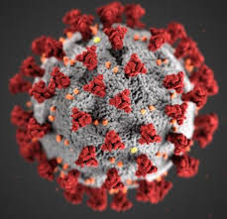
Has your research productivity been impacted by COVID-19 during your ESI period?
Submit a request for an extension to your NIH ESI status. Describe the nature of the disruption to your research in the request.
NIH will consider requests to extend the ESI status period for reasons that can include the following, as determined on a case-by-case basis at the sole discretion of NIH.
Medical concerns
Disability
Family care responsibilities
Natural disasters
Active duty military service
Submit an ESI Extension Request using link found in the Education section of the PI's Personal Profile in eRA Commons.
https://nexus.od.nih.gov/all/2020/04/09/can-esi-status-be-extended-due-to-disruptions-from-covid-19/
https://era.nih.gov/erahelp/ESIE_ext/Default.htm#cshid=4

Slide 31
NIH Anti-Harassment Policy – Current Actions
The 2018 National Academies report on sexual harassment of women in science found that “federal agencies may be perpetuating the problem of sexual harassment.” The NIH Director stated concern that NIH has been part of the problem. Thus, the NIH is working on:
Demonstrating accountability and transparency
A clear message to institutions that NIH funds and researchers who lead the research that sexual harassment is unacceptable.
Clarifying expectations for institutions and investigators to ensure safe workplace
Read more on the 6/14/2019 “Open Mike” blog
Providing clear channels of communication to the NIH
For concerns related to harassment affecting NIH-funded research, a confidential email can be sent to: GranteeHarassment@od.nih.gov or call (301) 480-6701 or use the confidential webform: https://public.era.nih.gov/shape/public/index.era
https://nexus.od.nih.gov/all/tag/anti-sexual-harassment/
https://grants.nih.gov/grants/policy/harassment.htm

Slide 32
Final Points
Learn the rules
Cultivate relationships with program staff
If a Program Officer isn’t helpful, find one who is
Take progress reports seriously
Be a good colleague, collaborator, and mentor.
Secret to
success
NIH

Slide 33
Acknowledgements
Special thanks to Anita Bechtholt for sharing her slides from previous year’s presentations. Many slides here were adapted from her talk.

Slide 34
Contacts Slide
Thank you for your attention
Email: nas.zahir@nih.gov
Twitter: @nas_zahir
Follow NIH
@NIH
@NIHfunding
@NIHgrants
See NIH website for more information on grants and funding
https://www.nih.gov/grants-funding

