Slide 1
NIH Next Generation Research Initiative: Training Future Biomedical Researchers Biomedical Researchers
After Hours Conversation Live
Transition
Training
Navigation
Mentorship
Support
Funding

Slide 2
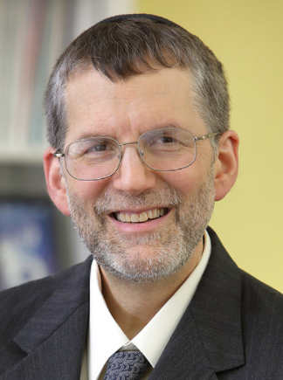
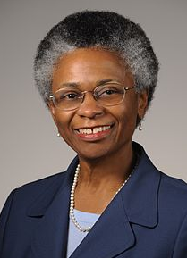
Panelists
Michael Lauer, M.D.
Deputy Director for Extramural Research
michael.lauer@nih.gov
Marie Bernard, M.D.
Chief Officer for Scientific
Workforce Diversity
marie.bernard@nih.gov

Slide 3
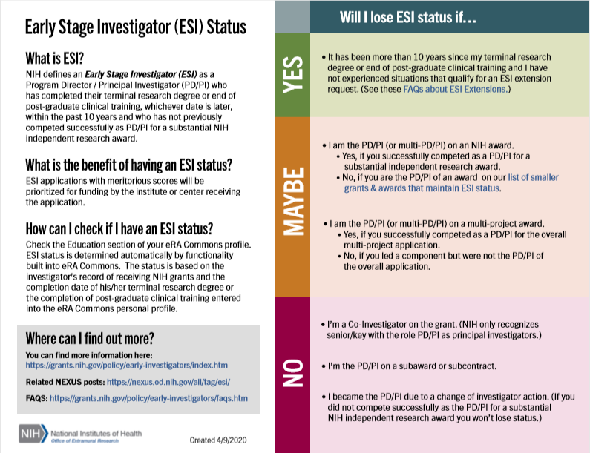
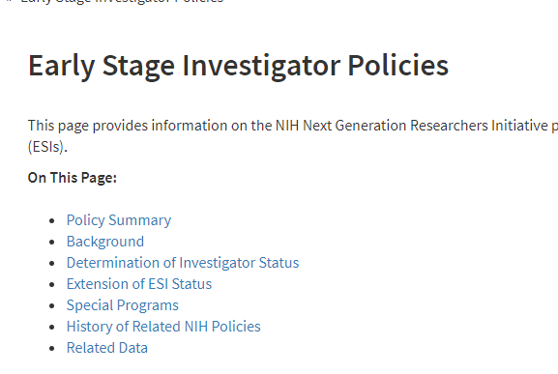
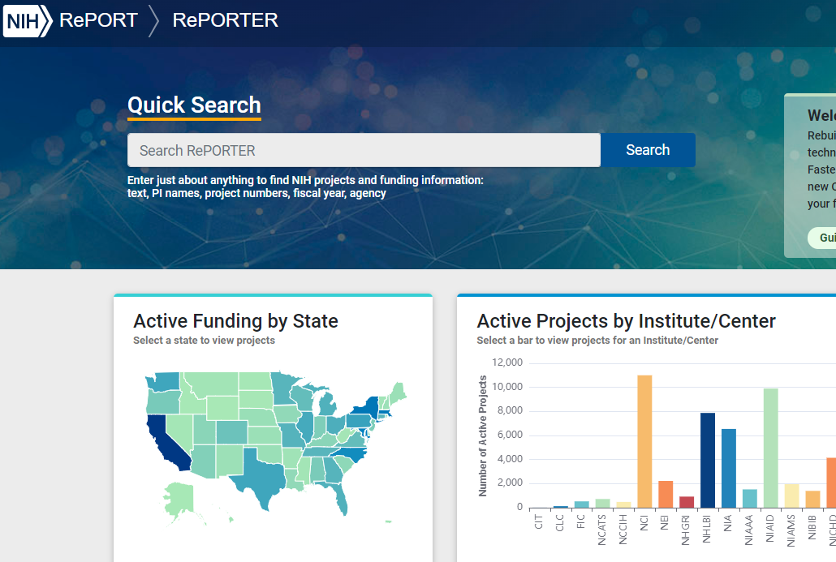
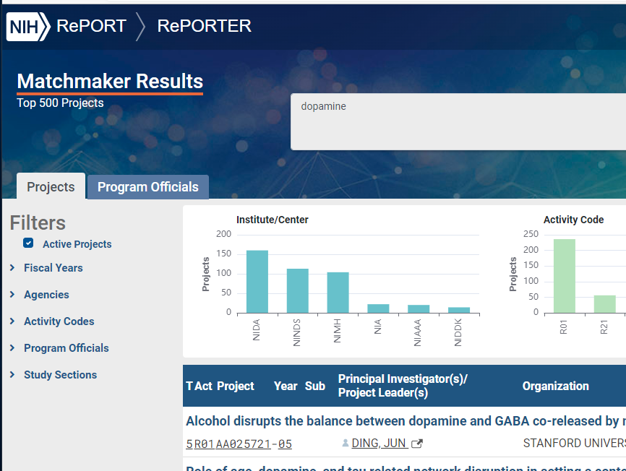
Important Resources
Scientific Workforce Diversity
https://diversity.nih.gov
NGRI Website
https://grants.nih.gov/ngri.htm
NGRI Policies Impacting Early Career Investigators
https://grants.nih.gov/policy/early-investigators/index.htm
Programs for Early Career Investigators
https://researchtraining.nih.gov/career/early-career
FAQs: https://grants.nih.gov/faqs#/early-investigators.htm
Information on ESI Extension Requests
https://era.nih.gov/erahelp/ESIE_ext/Default.htm#cshid=4
https://www.youtube.com/watch?v=2Fr9gN7cymQ&feature=youtu.be
Instructions: Early-Stage Investigator Program Overview (nih.gov)
COVID-related Extensions
NOT-OD-21-052: Reminder Requesting Extensions for Early Career Scientists Whose Career Trajectories Have Been Significantly Impacted by COVID-19 (nih.gov)
https://nexus.od.nih.gov/all/2020/04/09/can-esi-status-be-extended-due-to-disruptions-from-covid-19/
Nexus Blog –
Data on Implementing NIH’s Next Generation Researchers Initiative – NIH Extramural Nexus
NIH Reporter & Matchmaker Tool
https://reporter.nih.gov; https://reporter.nih.gov/matchmaker

Slide 4
Q&A

