Slide 1
NIH & You: Working to UNITE the Extramural Research Community
After Hours Conversation Live
Transition
Training
Navigation
Mentorship
Support
Funding

Slide 2
Session Description
The UNITE initiative was established to identify and address structural racism within the NIH-supported and the greater scientific community. With representation from across the NIH Institutes and Centers, UNITE aims to establish an equitable and civil culture within the biomedical research enterprise and reduce barriers to racial equity in the biomedical research workforce.
In this session, representatives from the UNITE Initiative will provide an overview of the UNITE Initiative and discuss current and future goals of the effort.

Slide 3
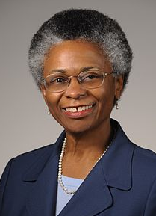
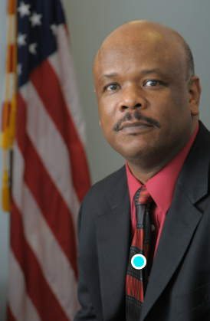
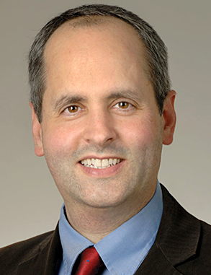
Your Panelists
Marie Bernard, M.D.
Chief Officer for Scientific
Workforce Diversity
marie.bernard@nih.gov
Alfred Johnson, Ph.D.
Deputy Director for Management
alfred.johnson@nih.gov
Jon Lorsch, Ph.D.
Director, National Institute on General Medical Sciences
jon.olrsch@nih.gov

Slide 4
NIH UNITE Initiative
Marie A. Bernard, MD; Albert C. Johnson, PhD; Jon Lorsch, PhD
11/1/21
nih.gov/ending-structural-racism

Slide 5
The NIH UNITE Initiative
Events of 2020 brought into sharp relief the ongoing reality of racial injustice in our country, and the responsibility of all of us to address this issue
A series of intense Institute and Center Director meeting discussions were held to identify initial issues
Two self-assembled affinity groups at NIH (8CRE, AA/B Scientists) and the Anti-Harassment SC met with NIH leadership for candid discussions that informed next steps
We have arrived at a shared commitment to address structural racism: we must not allow this pivotal moment to pass
nih.gov/ending-structural-racism
The NIH UNITE Initiative to Strengthen Diversity, Equity, and Inclusion: Together, We’re Stronger

Slide 6
The NIH UNITE Initiative
U N I T E
Understanding stakeholder experiences through listening and learning
New research on health disparities/minority health/health equity
Improving the NIH Culture and Structure for Equity, Inclusion, and Excellence
Transparency, communication, and accountability with our internal and external stakeholders
Extramural Research Ecosystem: Changing Policy, Culture, and Structure to Promote Workforce Diversity
nih.gov/ending-structural-racism

Slide 7
Initial UNITE Recommendations
Publicly commit to identifying and correcting any NIH policies or practices that may have helped to perpetuate structural racism

Slide 8
Acknowledgement
https://www.nih.gov/ending-structural-racism

Slide 9
Initial UNITE Recommendations and Actions
Publicly commit to identifying and correcting any NIH policies or practices that may have helped to perpetuate structural racism – Published 3/1/21
Continue to aggressively implement approaches to address the “Ginther Gap” and
enhance portfolio diversity

Slide 10
R01eq Applicants and Funding Rates Type 1 and Type 2: FY2013 and FY2020 (by Race/Ethnicity)
Number of Applicants
19,919
20,000
1.8% AA/B 2.3% AA/B
4.4% Hispanic ^{16,918} 5.2% Hispanic
18,000
16,000
14,000
12,000
10,000
8,000
7,791
6,000
5,266
4,000
2,000
1,034
1,554
425
65
703
*
0
51
18
29
2013
2020
* No Awarded Applicants

Slide 11
R01eq Applicants and Funding Rates Type 1 and Type 2: FY2013 and FY2020 (by Race/Ethnicity)
Number of Applicants
1.8% AA/B 2.3% AA/B
4.4% Hispanic ^{16,918} 5.2% Hispanic
Funding Rates
19,919
40.0%
20,000
1.1% AA/B
3.7% Hispanic
1.8% AA/B
4.8% Hispanic
18,000
35.0%
16,000
31.3%
30.0%
14,000
27.5% 27.4%
24.6%
N= 428
N= 2138
12,000
25.0%
N= 16
23.6%
21.8%
N= 166
10,000
20.0%
19.6%
N=
<12
_{17.7%} 18.1%
8,000
7,791
N= 183
N= 953
15.0%
12.2%
6,000
5,266
N= 52
10.3%
10.0%
4,000
5.0%
N= 3692
N=
N= 6230
2,000
1,554
<12
425
1,034
703
*
51
18
65
29
0.0%
0.0%
0
2013
2020
2013
2020
* No Awarded Applicants

Slide 12
Initial UNITE Recommendations and Actions
Publicly commit to identifying and correcting any NIH policies or practices that may have helped to perpetuate structural racism – Published 3/1/21
Continue to aggressively implement approaches to address the “Ginther Gap” and
enhance portfolio diversity - Ongoing
Launch a multi-phased, -tiered, and -integrated Common Fund Initiative focused on transformative health disparities research initiatives to reduce health disparities/ inequities

Slide 13
Action
NIH Common Fund Transformative Research to Address Health Disparities and Advance Health Equity – Committed up to $58M
Two FOAs released 3/26/21: 11 awards announced 10/13/21
RFA-RM-21-021 Transformative Research to Address Health Disparities and Advance Health Equity (U01 Clinical Trial Allowed) – 6 awards
RFA-RM-21-022 Transformative Research to Address Health Disparities and Advance Health Equity at Minority Serving Institutions (U01 Clinical Trial Allowed) - 5 awards; additional competition FY 22

Slide 14
Initial UNITE Recommendations and Actions
Publicly commit to identifying and correcting any NIH policies or practices that may have helped to perpetuate structural racism – Published 3/1/21
Continue to aggressively implement approaches to address the “Ginther Gap” and
enhance portfolio diversity - Ongoing
Launch a multi-phased, -tiered, and -integrated Common Fund Initiative focused on transformative health disparities research initiatives to reduce health disparities/ inequities – Implemented
Ensure a robust NIH Enterprise-wide commitment to support the NIMHD FOA
focused on the effects of structural racism and discrimination on health disparities/ inequities; encourage funding levels that are commensurate with overall IC resources

Slide 15
Initial UNITE Recommendations and Actions
Publicly commit to identifying and correcting any NIH policies or practices that may have helped to perpetuate structural racism – Published 3/1/21
Continue to aggressively implement approaches to address the “Ginther Gap” and
enhance portfolio diversity - Ongoing
Launch a multi-phased, -tiered, and -integrated Common Fund Initiative focused on transformative health disparities research initiatives to reduce health disparities/ inequities – Implemented
Ensure a robust NIH Enterprise-wide commitment to support the NIMHD FOA
focused on the effects of structural racism and discrimination on health disparities/ inequities; encourage funding levels that are commensurate with overall IC resources

Slide 16
Action
With the commitment of up to
$30.8 M by 25 ICOs:
Letters of intent due 7/20/21
Applications due 8/24/21
https://grants.nih.gov/grants/guide/rfa-files/RFA-MD-21-004.html

Slide 17
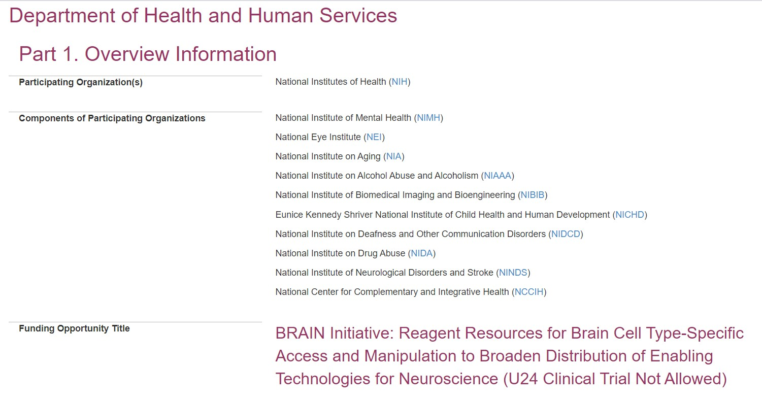
Action – BRAIN FOA
First NIH FOA using Plan to Enhance Diverse Perspectives as a consideration for scoring
https://grants.nih.gov/grants/guide/rf a-files/RFA-MH-21-180.html

Slide 18
Initial UNITE Recommendations
Publicly commit to identifying and correcting any NIH policies or practices that may have helped to perpetuate structural racism – Published 3/1/21
Continue to aggressively implement approaches to address the “Ginther Gap” and
enhance portfolio diversity - Ongoing
Launch a multi-phased, -tiered, and -integrated Common Fund Initiative focused on transformative health disparities research initiatives to reduce health disparities/ inequities – Implemented
Ensure a robust NIH Enterprise-wide commitment to support the NIMHD FOA
focused on the effects of structural racism and discrimination on health disparities/ inequities; encourage funding levels that are commensurate with overall IC resources – RFA published 3/23/21 with 25 ICOs
Develop a sustainable process to systematically gather and make public the demographics of our internal and external workforce

Slide 19
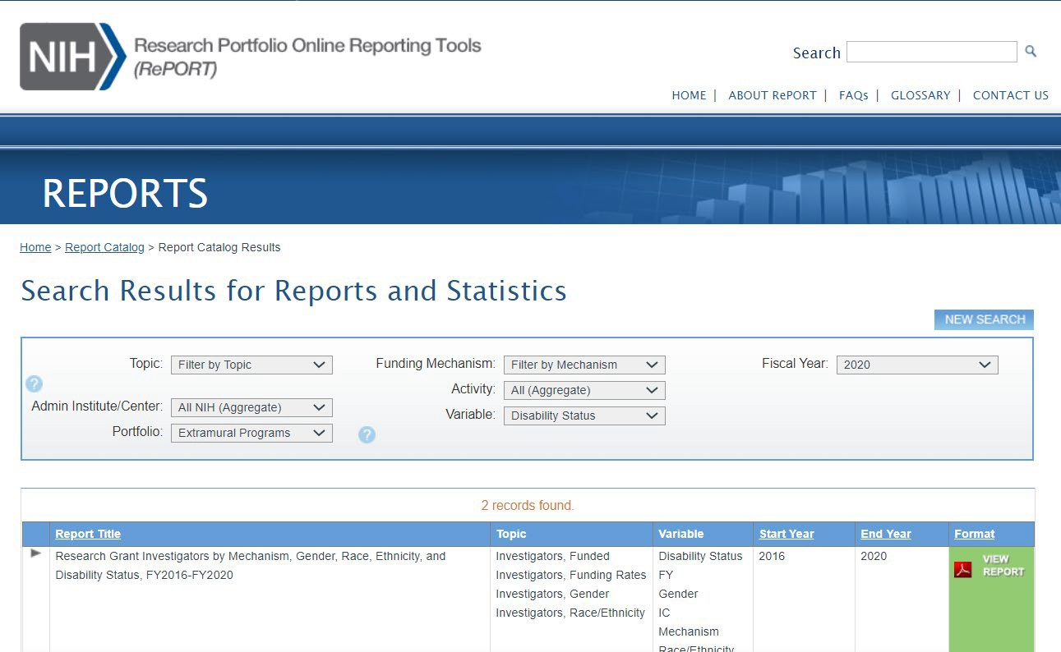
Action – NIH Data by Race/Ethnicity, Disability Status
https://report.nih.gov/sites/report/f iles/docs/NIH_Principal_Investigator s_by_Gender_Race_Ethnicity_and_ Disability_2016-
2020_02_23_2021_PDF.pdf

Slide 20
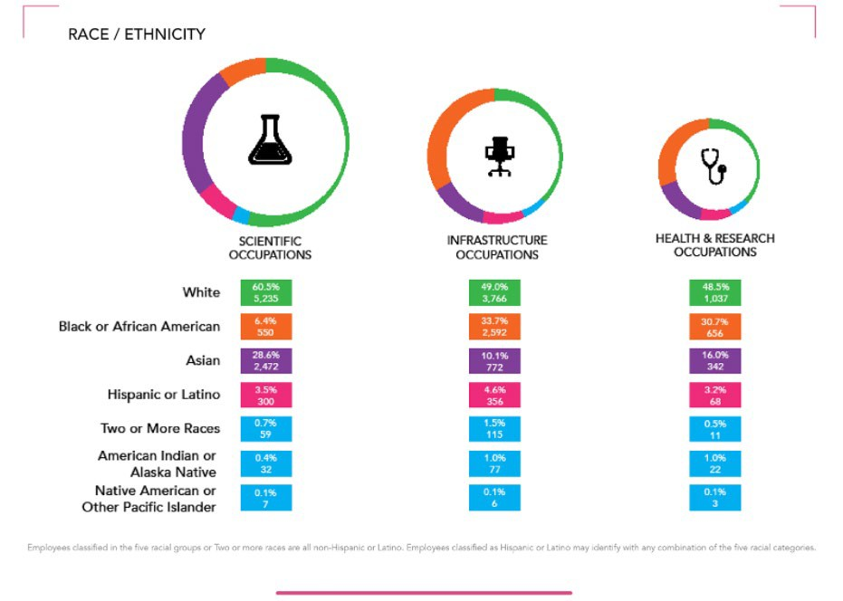
Action – NIH Internal Data FY 21, Q2
https://www.edi.nih.gov/people/res ources/advancing-racial-equity/nih- workforce-profile-fy21q02

Slide 21
UNITE Recommendations and Actions Going Forward

Slide 22
UNITE Actions/Priorities Going Forward – Next 6 Months
To facilitate HD/MH/HE research, the President’s budget has proposed increased funding for NIMHD, NINR, NHLBI, and FIC

Slide 23
UNITE Actions/Priorities Going Forward – Next 6 Months
UNITE Actions/Priorities Going Forward – Next 6 Months
To facilitate HD/MH/HE research, the President’s budget has proposed increased funding for NIMHD, NINR, NHLBI, and FIC
Continue to listen and learn from a wide variety of stakeholders, including those who are not frequently engaged
Develop actionable data dashboards that track and provide
visualizations of intramural workforce and NIH HD/MH/HE research investments with key performance indicators and metrics
Additional FOAs that focus on IC-specific disease/topic areas related to HD/MH/HE
Develop programs to spur institutional culture change in support of inclusivity and equity

Slide 24
Faculty Institutional Recruitment for Sustainable Transformation (FIRST)
Overarching Goal
Create cultures of inclusive excellence
Program Objectives:
Faculty cohort model for hiring, multi-level mentoring, professional development
Integrated, institution-wide systems to address bias, faculty equity, mentoring, and work/life issues
Coordination and Evaluation Center (CEC): Independent program evaluation - faculty and institutional level
Estimated Funds Available: $241 M over 9 years
diversity.nih.gov
www.diversity.nih.gov
21

Slide 25
Inclusive Excellence
Initial FIRST Cohorts
diversity.nih.gov
www.diversity.nih.gov

Slide 26
Inclusive Excellence
FIRST Coordination and Evaluation Center
diversity.nih.gov
www.diversity.nih.gov

Slide 27
Injustice anywhere is a threat to justice everywhere
Martin Luther King, Jr

Slide 28
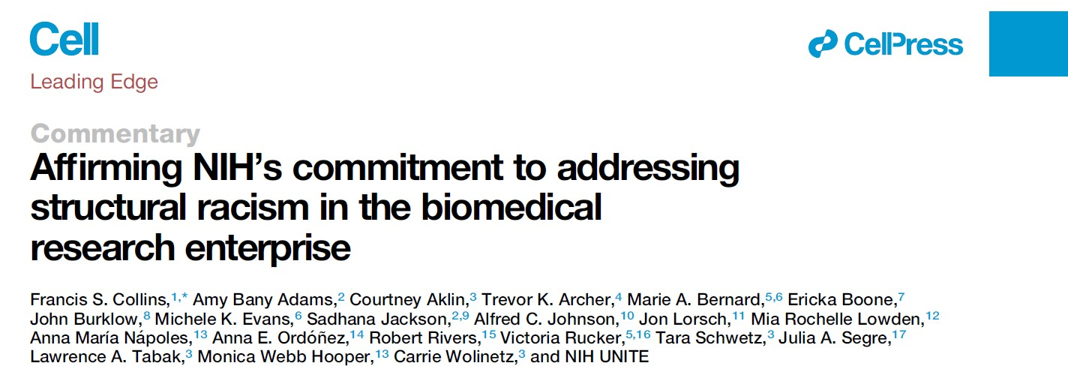
Cell commentary
DOI: 10.1016/j.cell.2021.05.014 (2021).

Slide 29
The NIH UNITE Initiative
UNITE Co-Chairs
UNITE Program Manager
Victoria Rucker, Center for Information Technology/ NIH Office of the Director
UNITE Program Support
Brittany Chao, NIH Office of the Director
Marzjah Esther, NIH Office of the Director
Marie A. Bernard, NIH Office of the Director/Office of the Chief Officer for Scientific Workforce Diversity
Alfred Johnson, NIH Office of the Director/
Office of Management
Lawrence Tabak, NIH Office of the Director
U
N
Michele K. Evans (NIA)
Anna María Nápoles (NIMHD) Robert Rivers (NIDDK)
Gwen Bishop (NIDCD) Vence Bonham (NHGRI) Juanita Chinn (NICHD)
Janine Clayton (ORWH/OD)
Kathy Etz (NIDA)
Justin Hentges (AoU/OD) Daryl Holder (CC) Samantha Jonson (NCATS)
Joan Romaine (NIAAA) Asha Storm (NIBIB) Shannon Zenk (NINR)
+Marzjah Esther (OD)
I
T
E
Courtney Aklin (IMOD/OD)
Mia Rochelle Lowden (ORIP/OD)
Monica Webb Hooper (NIMHD)
Shelli Avenevoli (NIMH) Dexter Collins (FIC) Laura Cooper (NIAMS) Kevin Davis (CIT)
Leslie Littlejohn (NIAMS) Troy Muhammad (NCI)
Ian Myles (NIAID) Roland Owens (OIR/OD) Kelly Ten Hagen (NIDCR) Brian Trent (NEI)
Della White (NCCIH)
+Cara Finley (IMOD/OD)
+Melissa Laitner (OD)
+Vanessa Marshall (NIMHD)
+Kamilah Rashid (IMOD/OD)
Trevor Archer (NIEHS)
Marie A. Bernard (COSWD/OD)
Treava Hopkins-Laboy (OD) Alfred Johnson (OM/OD) Talin Barnes (NIEHS)
Gwyn Collins (NCI)
Charles Egwuagu (NEI) Courtney Fitzhugh (NHLBI) Kenneth Gibbs (NIGMS) Kendall Hill (CSR)
Camille Hoover (NIDDK) Laura Koehly (NHGRI) Shawn Lewis (NINR) Marguerite Matthews (NINDS)
Shaun Sims (NIBIB) Brenda Robles (CC)
+Melissa Espinoza (NIA)
Amy Bany Adams (NINDS) John Burklow (IMOD/OD) Sadhana Jackson (NINDS, NCI)
Mohammed Aiyegbo (NIAID) Albert Avila (NIDA)
Samantha Calabrese (NICHD)
Angie Cruz-Albertorio (NCATS) Carla Garnett (OCPL/OD) Lakshmi Grama (NCI)
Carl Hashimoto (OIR/OD)
Nakia Makonnen (NIDCD) Eric Refsland (NIAID) Eric Sid (NCATS)
Wayne Wang (NHLBI)
Cassie Williams (NIAAA)
+Jesse Isaacman-Beck (IMOD/OD)
Ericka Boone (OER/OD) Jon Lorsch (NIGMS)
Anna E. Ordóñez (NIMH)
Eddie Billingslea (ORWH/OD) Tiffany Calvert (NIBIB)
Rena D’Souza (NIDCR) Zeynep Erim (NIBIB)
Leonardo Garzon-Velez (FIC) Bettie Graham (NHGRI) Leah Hubbard (NCI)
Patricia Jones (NIA)
Vonda Smith (CSR)
James Washington (NINDS) Maryam Zaringhalam (NLM)
+Mark Stevens (OM/OD)
Committee Co-Chairs
+Staff Leads
nih.gov/ending-structural-racism

Slide 30
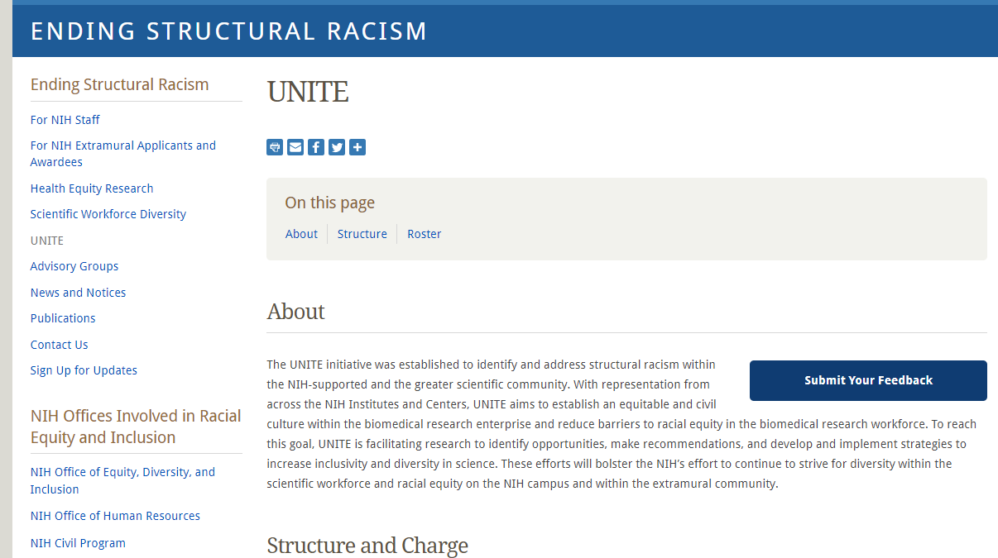
Resources
The NIH UNITE Initiative | National Institutes of Health (NIH)
Ending Structural Racism | National Institutes of Health (NIH)

Slide 31
Q&A

