Slide 1
SEEDing Healthcare Solutions
Matt McMahon, PhD
Director, SEED (Small business Education and Entrepreneurial Development) Office of Extramural Research, NIH

Slide 2
NIH

Slide 3
NIH SEED – Small business Education and Entrepreneurial Development
(Small business Education and Entrepreneurial Development)

Slide 4
Small business Education and Entrepreneurial Development (SEED)
Mission​
Accelerate the conversion of scientific discoveries into impactful healthcare solutions. ​
Vision​
A world where scientists are empowered to improve the lives of patients and their families.
Small Business Innovation
Innovator Support
Academic Innovation
seed.nih.gov

Slide 5
What do academic innovators need to be successful?
Project Funding
Training and Resources
Educational Coaching
Personalized feedback

Slide 6
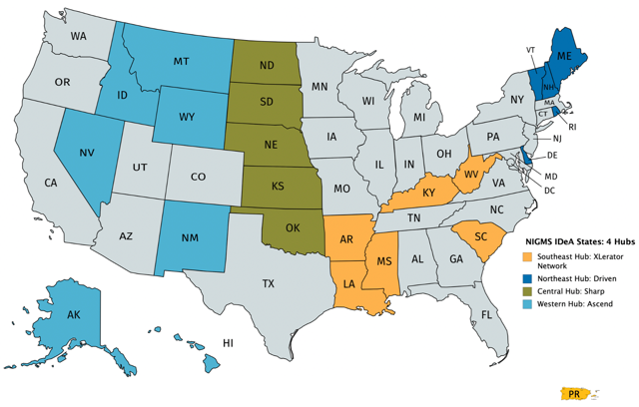
NIH Proof-of-Concept Network
Supporting innovators at over 100 Institutions
NCAI Centers:
NHLBI focus, established 2013
REACH 2015 Hubs:
Trans-NIH, established 2015
REACH 2019 Hubs:
Trans-NIH, established 2019
NIGMS IDeA States Regional Hubs
Southeast: XLerator Network
Northeast: DRIVEN
Central: SHARP
Western: ASCEND

Slide 7
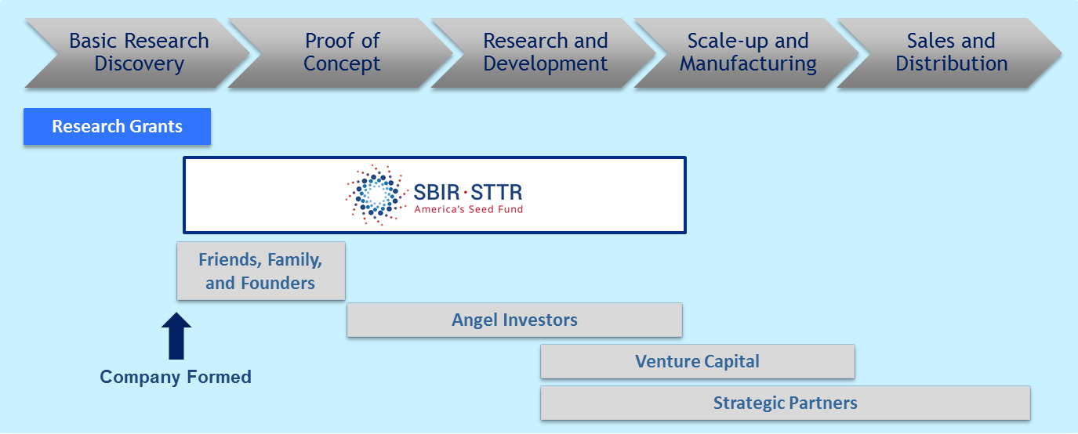
NIH Small Business Programs
The largest sources of early-stage capital for life sciences in the U.S.
Free money – not a loan
Companies own the data and intellectual property they create
Awardees can leverage funding to attract investors and partners
Small Business Innovation Research
+
Small Business Technology Transfer
=
$1.2 billion
every year!

Slide 8
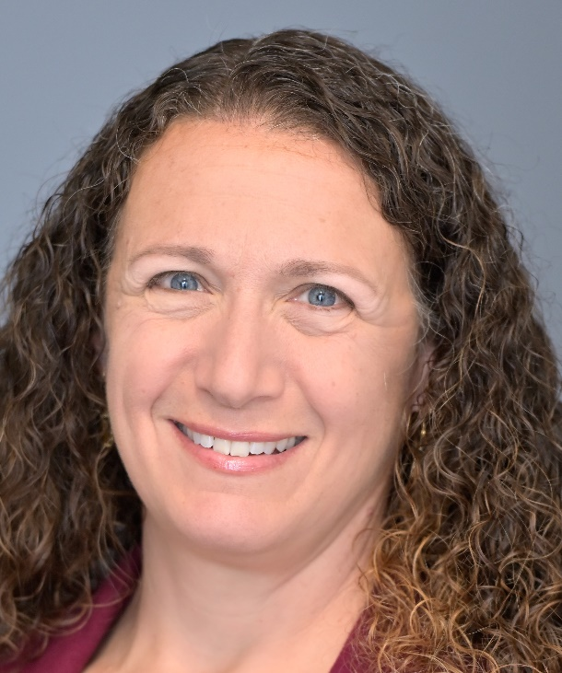
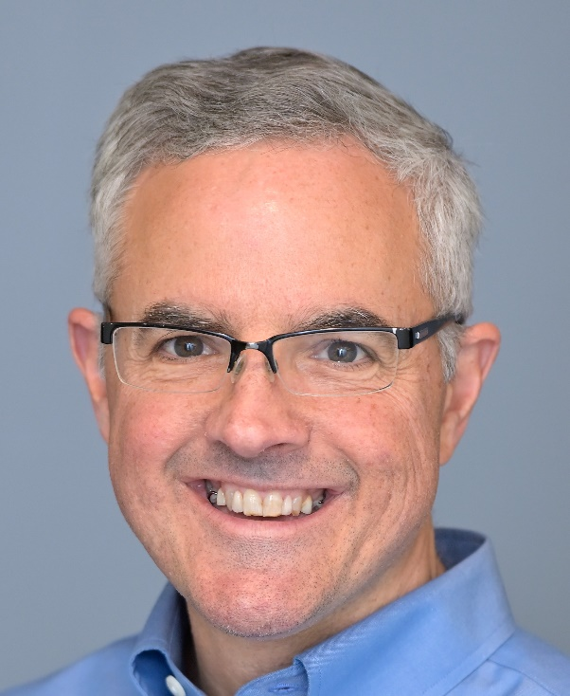
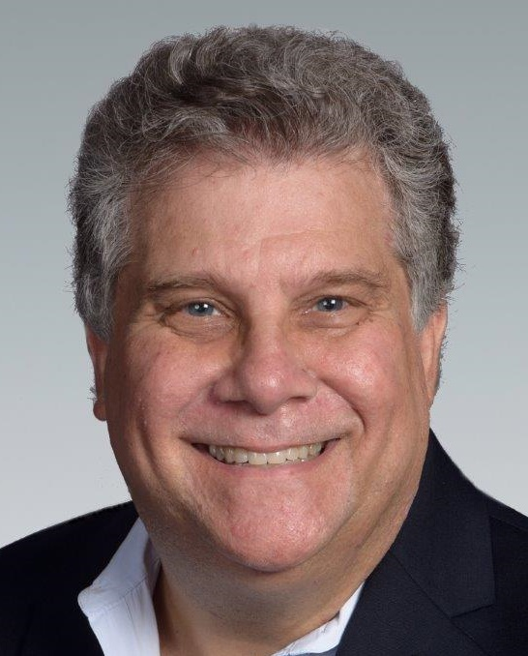
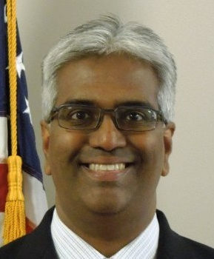
Supporting Innovators
Strategy, Finance & Commercialization Experts
Partnering Opportunities and
Pitch Coaching
Sr. Regulatory Specialist
Investor-in-Residence
Entrepreneurs-in-Residence
Intellectual Property (USPTO)

Slide 9
Small business Education and Entrepreneurial Development (SEED)
Tomorrow:
Friday, October 30th
2:00 PM – 2:45 PM EST
From Bench to Boardroom: Support for Small Businesses
Small Business Innovation
Innovator Support
Academic Innovation
1:00 PM – 1:45 PM EST
Helping Academics Address Unmet Medical Needs
3:00 PM – 3:45 PM EST
Beyond Funding: NIH Support for Innovators
4:00 PM – 4:45 PM EST
Innovators in Action: Case Studies
Notes:
508

