Slide 1
RIGOR AND REPRODUCIBILITY:
BACK TO BASICS
Patricia Valdez, Ph.D.
NIH Extramural Research Integrity Officer
National Institutes of Health

Slide 2
Overview
Why the concern about reproducibility?
The NIH response
Updates to grant applications
Training and Resources

Slide 3
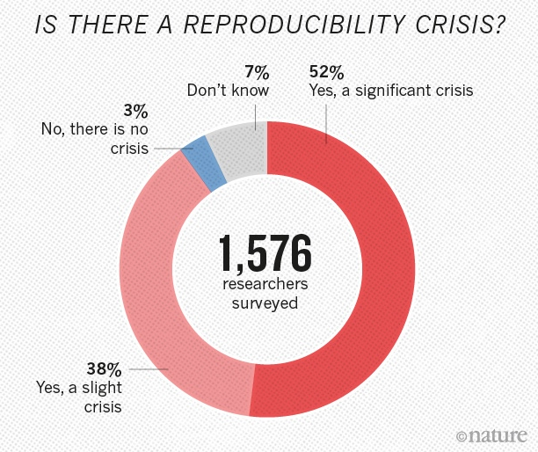
Is there a reproducibility crisis?
Notes:
Nature's survey of 1,576 researchers who took a brief online questionnaire on reproducibility in research.
90% of respondents thought there was a reproducibility crisis.
Over half thought it was a significant crisis.

Slide 4


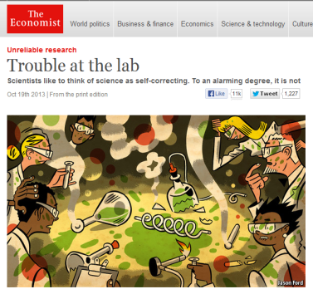
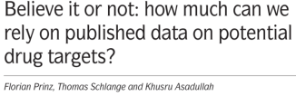



The Reproducibility Challenge
Noted by research community; in multiple publications
  Across research areas
  Especially in preclinical research
Notes:
Noted by research community; in multiple publications
Across research areas
Especially in preclinical research
Pharmaceutical companies unable to reproduce much of the research in the scientific literature.
Begley – Amgen
Prinz - Bayer

Slide 5
Perspective
Notes:
In 2002, several studies reported that the drug minocycline increased survival of SOD1 mice, a model of ALS. NINDS funded a trial in which hundreds of ALS patients were treated with minocycline for 9 months. No benefit was found. Published in 2007.
Looking back at the preclinical studies, in many cases, blinding, randomization, sex, and transgene copy numbers were not reported.
In 2012, NINDS convened a workshop that led to publication of this perspective, calling for increased transparency in reporting.
NINDS Workshop: http://www.ninds.nih.gov/funding/areas/channels_synapses_and_circuits/rigor_and_transparency/index.htm
Landis et al article: http://www.nature.com/nature/journal/v490/n7419/full/nature11556.html

Slide 6
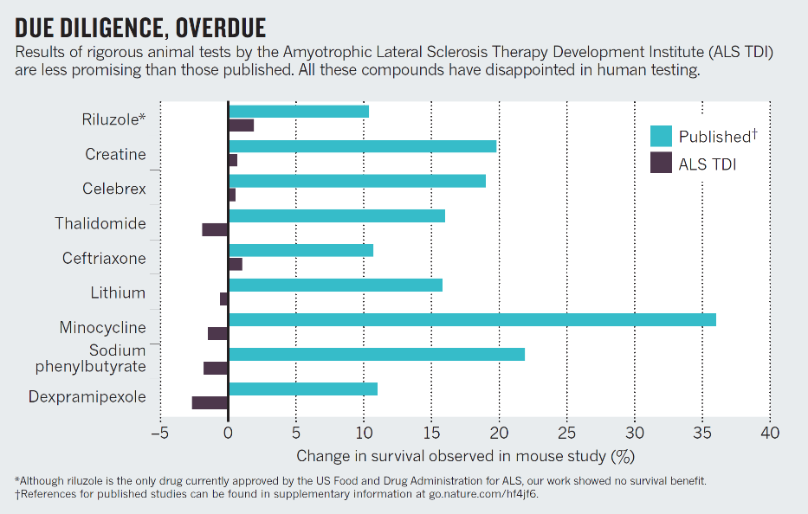
Due Diligence, Overdue
Perrin, Nature 2014; 507: 423-4255
Notes:
One year after the clinical trial data were published, ALS TDI published 5 years worth of rigorous studies exploring the effects of more than 70 drugs in a mouse model of ALS.
None showed a significant effect on the survival of mice, even those drugs previously reported to increase survival.
Small sample sizes likely led to erroneous results
http://www.nature.com/news/preclinical-research-make-mouse-studies-work-1.14913

Slide 7
Challenges to Rigor and Transparency in
Reporting Science
Science often viewed as self-correcting
  Immune from reproducibility problems?
  Principle remains true over the long-term
In the short- and medium-term, interrelated factors can short-circuit self-correction
  Leads to reproducibility problem
  Loss of time, money, careers, public confidence

Slide 8

Factors That “Short Circuit”
Self-correction
Poor training
  Inadequate experimental design
  Inappropriate use of statistics (“p-hacking”)
  Incomplete reporting of resources used and/or unexpected variability in resources
Notes:
Poor training
Inadequate experimental design – fundamental quality characteristics not reported/performed (e.g. blinded assessment, randomization, sample size calculations)
Inappropriate use of statistics (“p-hacking”)
Incomplete reporting of resources used and/or unexpected variability in resources

Slide 9


Factors That “Short Circuit”
Self-correction
Publication practices
  Difficulty in publishing negative findings
  Overemphasis on the “exciting, big picture” findings; leaves out necessary details
Current “hyper-competitive” environment
  Historically low funding rates
  Grant review and promotion decisions depend too much on “high profile” publications

Slide 10
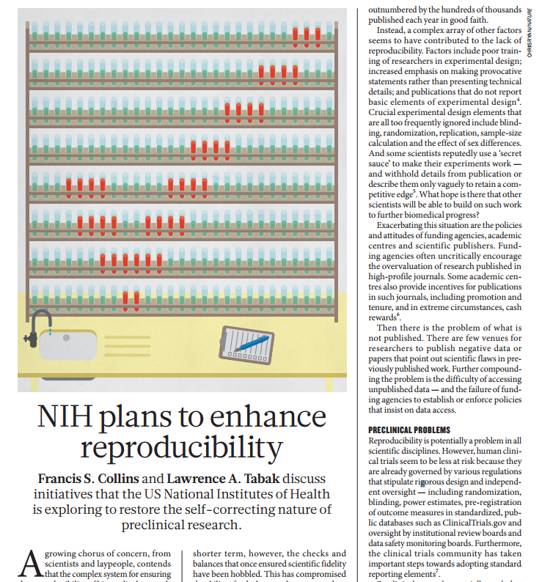
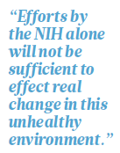
NIH Plans to Enhance Reproducibility

Slide 11
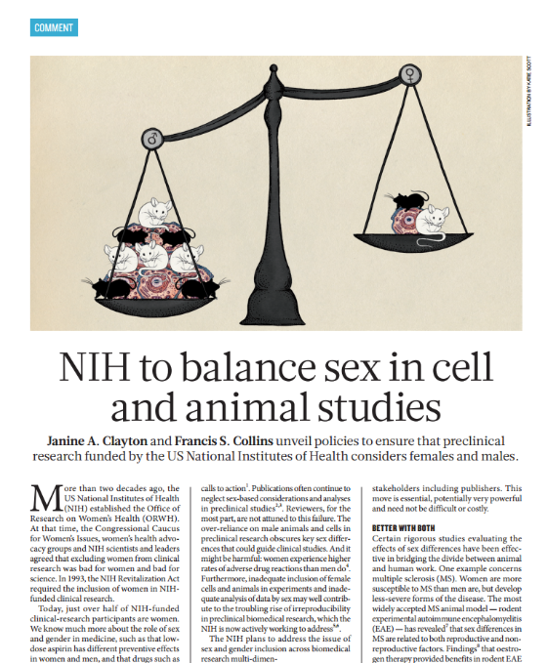
NIH to balance sex in cell and animal studies
“Over the course of FY 2015, NIH plans to roll out policies that will require applicants to address inclusion of both sexes in biomedical research.”
Notes:
http://www.nature.com/news/policy-nih-to-balance-sex-in-cell-and-animal-studies-1.15195

Slide 12
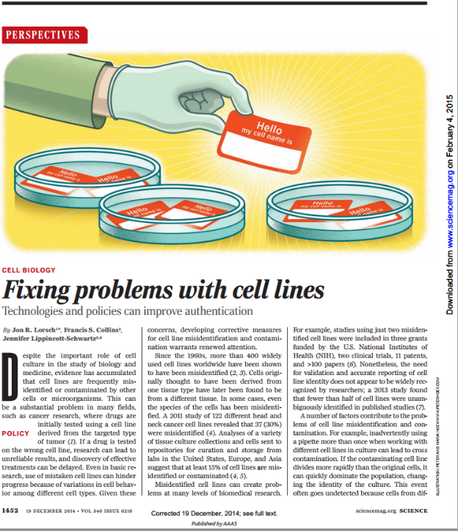
Fixing problems with cell lines
Since the 1960s, more than 400 widely used cell lines worldwide have been shown to have been misidentified
A 2011 study of 122 different head and neck cancer cell lines revealed that 37 (30%) were misidentified
Studies using just two misidentified cell lines were included in 3 grants funded by the NIH, two clinical trials, 11 patents, and >100 papers
Notes:
http://science.sciencemag.org/content/sci/346/6216/1452.full.pdf

Slide 13
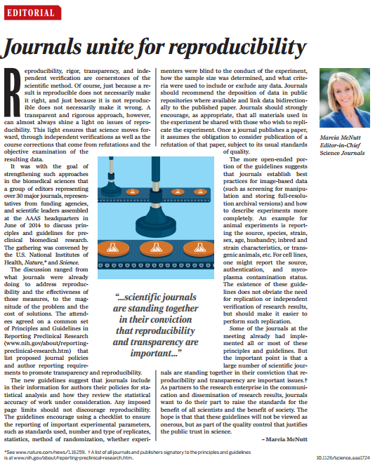
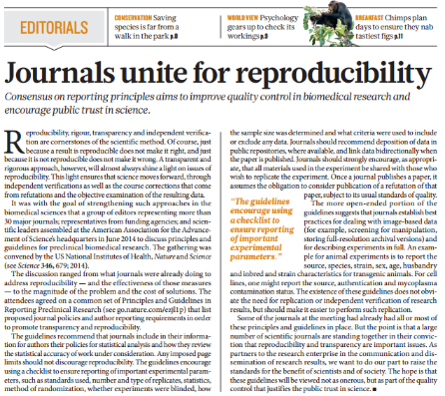
New Journal Policies to
Enhance Reproducibility

Slide 14
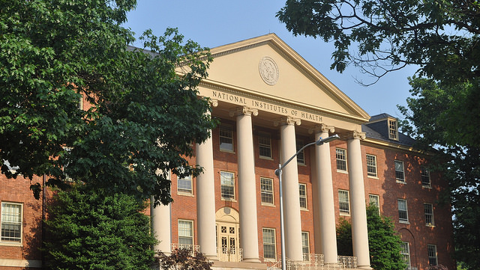
Our Guiding Principles for
Rigor & Transparency
Clarify NIH’s long-standing expectations regarding rigor and transparency in applications
Raise awareness and begin culture shifts in the scientific community
Improve the way that applicants describe their work; provide sufficient information for reviewers
As always, ensure that NIH is investing in the best science and minimizing unnecessary burden
14

Slide 15
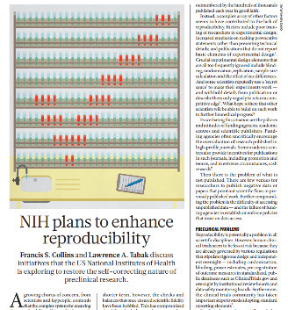
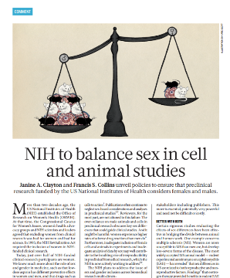
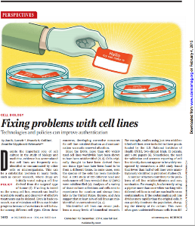
Four Areas of Clarification
Rigor of the prior research
Scientific rigor of the proposed research
Relevant biological variables, such as sex
Authentication of key biological and/or chemical resources
Starting with applications due on January 25, 2016

Slide 16
Policy Applies to:
Research
  Research
  Career Development
  Individual Fellowships
  Centers
  People-based
  Program Projects
  Small Business
  Resource-Related
Training
  Institutional Training & Career Development
  Fellowships
  Career Development
See the list of Activity Codes with Rigor

Slide 17
RPG Application and Review
Element of Rigor | Section of Application | Criterion Score | Additional Review Consideration | Contribute to Overall Impact?
Rigor of the Prior Research | Research Strategy | Significance | NA | Yes
Rigor of the Prior Research | Research Strategy | Approach | NA | Yes
Scientific Rigor | Research Strategy | Approach | NA | Yes
Consideration of Relevant Biological Variables Such as Sex | Research Strategy | Approach | NA | Yes
Authentication of Key Biological and/or Chemical Resources | Attachment | NA | Acceptable or Unacceptable | No

Slide 18
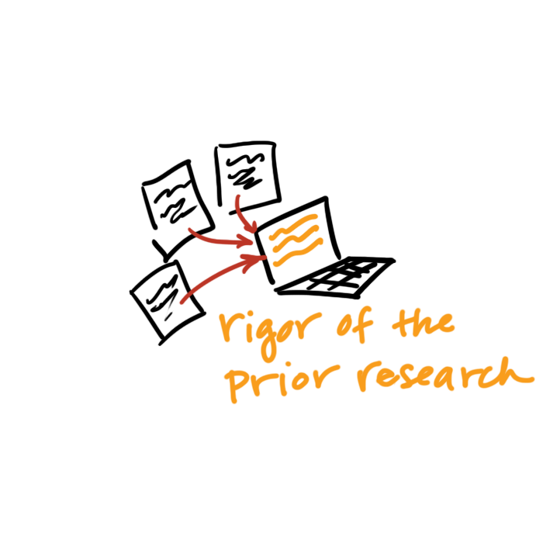
Rigor of the Prior Research
Assess the strength & weaknesses in the rigor of the prior research that serves as key support for the proposed research project.
  Prior research can include:
    observations,
    preliminary data, or
    published literature
Describe how the proposed research will address these weaknesses.

Slide 19
FAQ: What Do I Include When Describing the Rigor of the Prior Research?
When assessing the rigor of the prior research that serves as key support for the application, consider:
  Appropriate sample sizes
  Randomization and blinding
  Adequate positive and negative controls
  Appropriate statistical tests
  Consideration of relevant biological variables
  Authentication of key resources
  Other measures

Slide 20
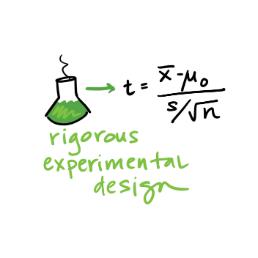
Scientific Rigor
The strict application of the scientific method to ensure robust and unbiased experimental design, methodology, analysis, interpretation and reporting of results.
Describe the experimental design and methods proposed and how they will achieve robust and unbiased results.
Notes:
This includes full transparency in reporting experimental details so that others may reproduce and extend the findings.

Slide 21
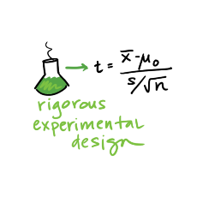
FAQ: How Much Detail Should
I Include to Address Scientific Rigor?
Succinctly state what is planned
  Include information on sample size estimation, effect size, blinding, randomization, statistical analyses…
  Describe experimental animal numbers here (power calc).
Be transparent about your plans for analysis
Stay within page limits

Slide 22
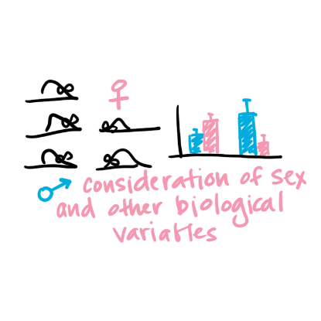
Relevant Biological Variables Such as Sex
Affect health or disease
  sex,
  age,
  weight, and
  underlying health conditions
Explain how relevant biological variables, such as sex, are factored into research designs & analyses for studies in vertebrate animals & humans.
Proposing to study one sex?
  Need strong justification from the scientific literature, preliminary data, or other relevant considerations
Notes:
Biological variables, such as sex, age, weight, and underlying health conditions, are often critical factors affecting health or disease.
NIH expects that sex as a biological variable will be factored into research designs, analyses, and reporting in vertebrate animal and human studies.
Strong justification from the scientific literature, preliminary data or other relevant considerations must be provided for applications proposing to study only one sex.

Slide 23

FAQ: Will I Have to Double My Animal Numbers?
May not need to power initial study to detect sex differences
  Begin to collect data on sex for early stage research.
Justification should be provided if the application proposes to study one sex
  sex-specific condition of phenomenon (e.g., ovarian or prostate cancer),
  acutely scarce resources, or
  sex-specific hypotheses possible due to known differences between males and females.
Cost and absence of known sex differences are inadequate justifications for not addressing sex.

Slide 24
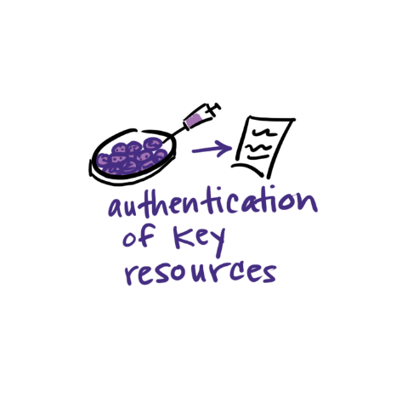
Authentication of Key Biological and/or Chemical Resources
Quality of established resources is critical
Cell lines, Antibodies, Chemicals, Mice, etc.
Provide a plan to regularly authenticate to ensure identity & validity
Each investigator determines which resources are key
Notes:
Key biological and/or chemical resources may or may not be generated with NIH funds and: 1) may differ from laboratory to laboratory or over time; 2) may have qualities and/or qualifications that could influence the research data; and 3) are integral to the proposed research. These include, but are not limited to, cell lines, specialty chemicals, antibodies, and other biologics.
Each investigator will have to determine which resources used in their research fit these criteria and are therefore key to the proposed research.

Slide 25
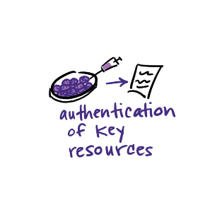
Reminder: Authentication Of Key Biological and/or Chemical Resources (NOT-OD-17-068)
Definition of key biological and/or chemical resources
Examples (cell lines, chemicals, genetically modified animals or cells)
Do not include:
  Plans for authentication of data sets, databases, machinery, or electronics
  Plans for the development and authentication of new key biological and/or chemical resources
  Plans for authentication of standard laboratory reagents that are not expected to vary
  Authentication or other data
Notes:
Key resources refer to established resources that will be used in the proposed research
If key resources have been purchased or obtained from an outside source that provided data on prior authentication, the investigator is still expected to provide their own authentication plans for these key resources.
Do not include authentication data in the Authentication of Key Biological and/or Chemical Resources attachment. Include only a description of the methods proposed to authenticate key resources.
Do not include plans for authentication of data sets, databases, machinery, or electronics in the Authentication of Key Biological and/or Chemical Resources attachment.
Do not include plans for development and authentication of new key biological and/or chemical resources (such as a human cancer cell line). Applications proposing to generate a new key biological and/or chemical resource must describe development and authentication of the resource in the Approach section.
Do not include plans for authentication of standard laboratory reagents that are not expected to vary. Examples are buffers and other common biologicals or chemicals.
We are encouraging scientific societies and the research community to develop standard approaches.
The Authentication plan is not scored, so if the application is meritorious, the applicant may work with the program officer to address any deficiencies prior to award.

Slide 26

Research Performance Progress Reports
(RPPR)
B.2 What was accomplished under these goals?
Goals are equivalent to specific aims. In the response, emphasize the approaches taken to ensure robust and unbiased results. Include the significance of the findings to the scientific field.
B.6 What do you plan to do for the next reporting period to accomplish the goals?
Include any important modifications to the original plans, including efforts to ensure that the approach is scientifically rigorous and results are robust and unbiased. Provide a scientific justification for any changes involving research with human subjects or vertebrate animals. A detailed description of such changes must be provided under Section F. Changes.

Slide 27
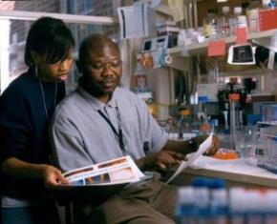
Training in Rigor
For applications submitted for due dates of May 25, 2020 and beyond (NOT-OD-20-033)
  Institutional training & career dev
  Individual career development
  Fellowships
Requires a description of training in techniques for rigorous and reproducible research
Contributes to Overall Impact Score
Notes:
Institutional Research Training
and
Institutional Career Development
The Program Plan section of the application will be expected to include a description of how the program and faculty will provide training in rigorous research design and relevant data science and quantitative approaches.
The requirement to include a Plan for Instruction in Methods for Enhancing Reproducibility attachment will be expanded to all applicants.
Fellowship
In describing their training goals and objectives in the Program Plan attachment, fellowship candidates will be expected to address, as applicable, any new research skills they plan to acquire in the areas of rigorous research design, experimental methods, quantitative approaches, and data analysis and interpretation.
Individual Career Development
In describing their career development plans in the Program Plan attachment, candidates for career development awards will be expected to address, as applicable, any new research skills they plan to acquire in the areas of rigorous research design, experimental methods, quantitative approaches, and data analysis and interpretation.

Slide 28

Clearinghouse for training modules to enhance data reproducibility
https://www.nigms.nih.gov/training/pages/clearinghouse-for-training-modules-to-enhance-data-reproducibility.aspx
Notes:
NIGMS Clearinghouse for Training Modules to Enhance Data Reproducibility

Slide 29
Sample of Modules Available on the NIGMS Clearinghouse
Statistical Topics for Reproducible Animal Research
Controls in Animal Studies for Rigor and Reproducibility
The BD2K Guide to the Fundamentals of Data Science Series
Cell Line Authentication Training
Society for Neuroscience Rigor and Reproducibility Training Webinars
Let's Experiment: A Guide for Scientists Working at the Bench

Slide 30
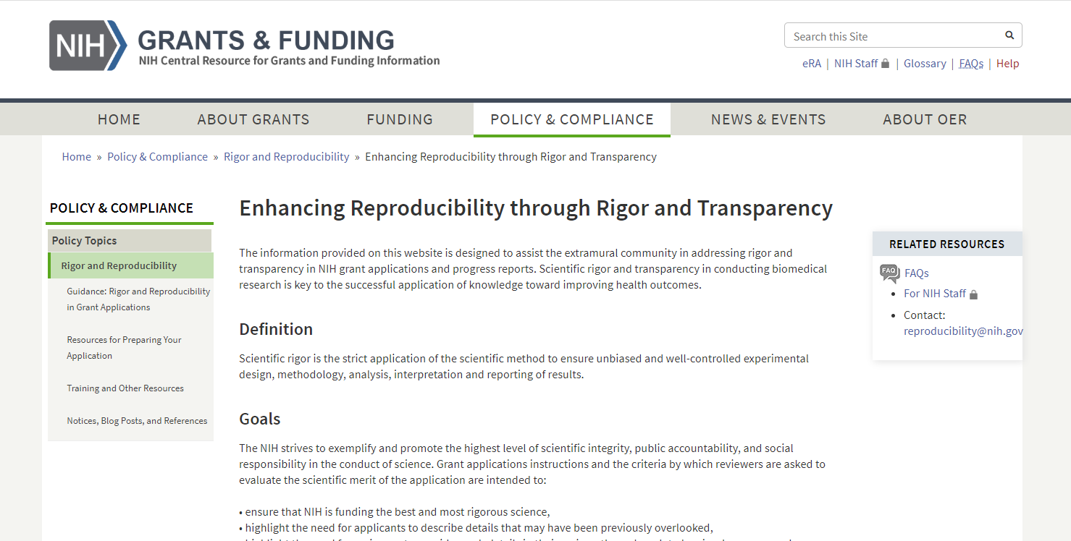
Reproducibility webpage
https://grants.nih.gov/policy/reproducibility/index.htm

Slide 31
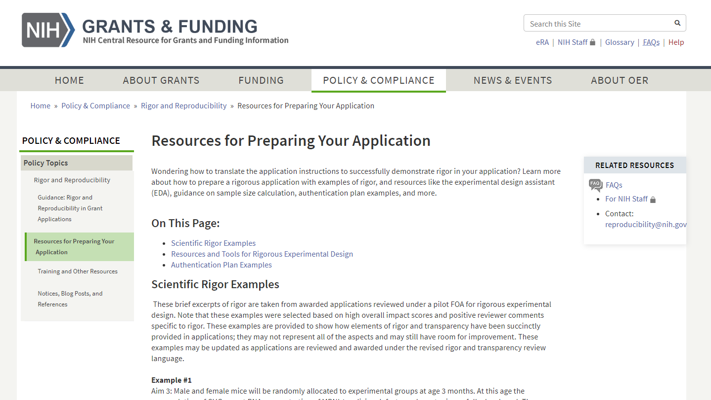
Resources for Preparing Your Application

Slide 32
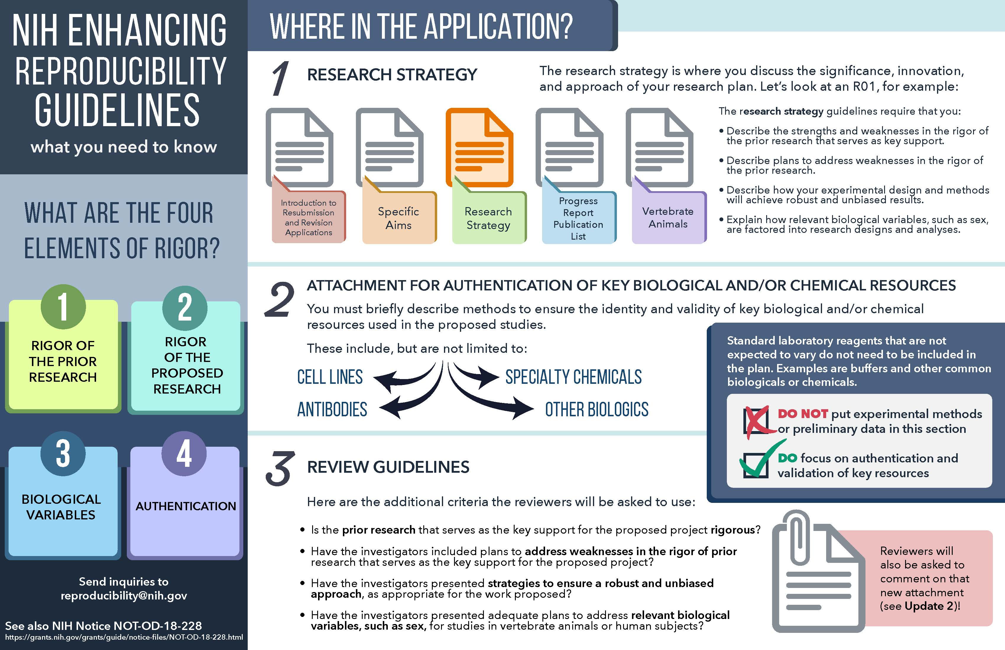
NIH Enhancing Reproducibility Guidelines handout pg1

Slide 33
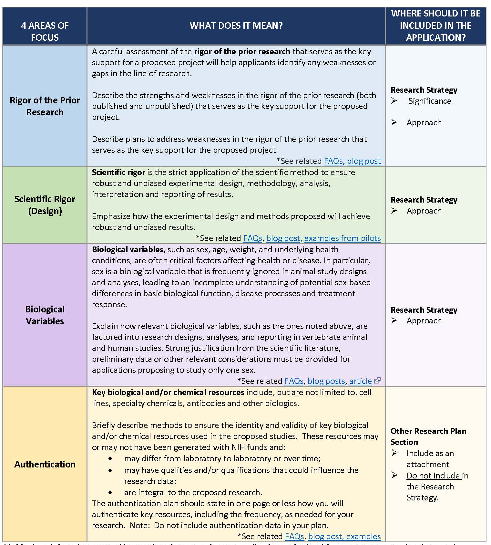
NIH Enhancing Reproducibility Guidelines handout pg 2

Slide 34
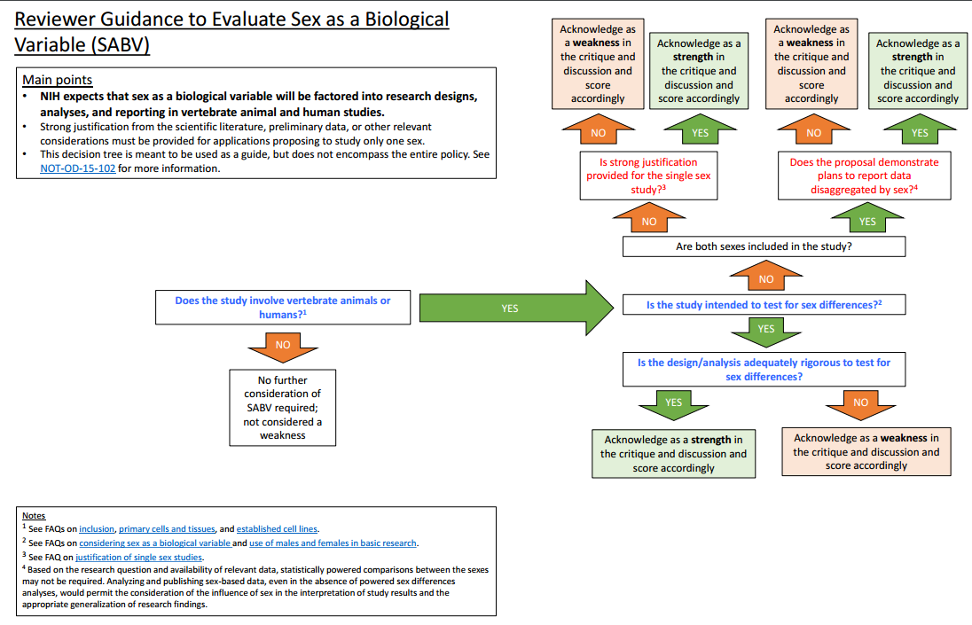
Reviewer Guidance to Evaluate Sex as a Biological Variable

Slide 35
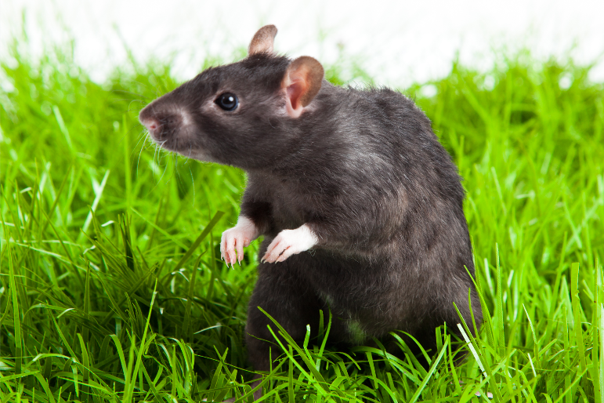
Upcoming: ACD Working Group on Enhancing
Reproducibility and Rigor in Animal Research
Identify gaps & opportunities to improve the rigor, reproducibility, translational validity, and transparency of animal models studies
Current state of science for validating alternative models to animal research
Registering animal studies that aim to lead to first in human trials
Financial implications
Training in rigor of animal research
More
https://acd.od.nih.gov/working-groups/eprar.html
Notes:
Building on the efforts already undertaken by NIH to improve rigor, reproducibility, and transparency, and taking into account work done by outside organizations, including the National Academies(link is external), the National Centre for the Replacement, Refinement, and Reduction of Animals in Research(link is external), and scientific societies e.g. American Physiological Society(link is external), Society for Neuroscience(link is external), the Working Group is charged by the NIH Director to:
Identify gaps and opportunities to improve the rigor, reproducibility, translational validity, and transparency of animal models studies
Evaluate how animal models of human disease are currently developed, validated, and accepted into routine use, and how this process could be improved
Assess the current state of science for validating alternative models to animal research
Consider benefits and burdens of registering animal studies that aim to lead to first human trials
Model financial implications of potential changes in the average costs of grants using animal models, the number of studies funded, or the need to develop consortia to achieve appropriate statistical power
Consider how rigor in animal research is incorporated into training

Slide 36
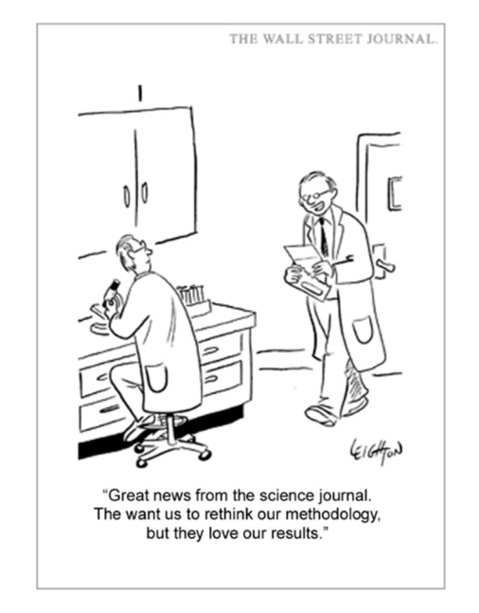
Thank You!
Questions? reproducibility@nih.gov

